Slide 1
Python week 7
Canberra Chinese School Sem1

Slide 2
Review (if statements)
if condition:
do something

Slide 3
Review
if condition:
do something
elif condition:
do something
else:
do something

Slide 4
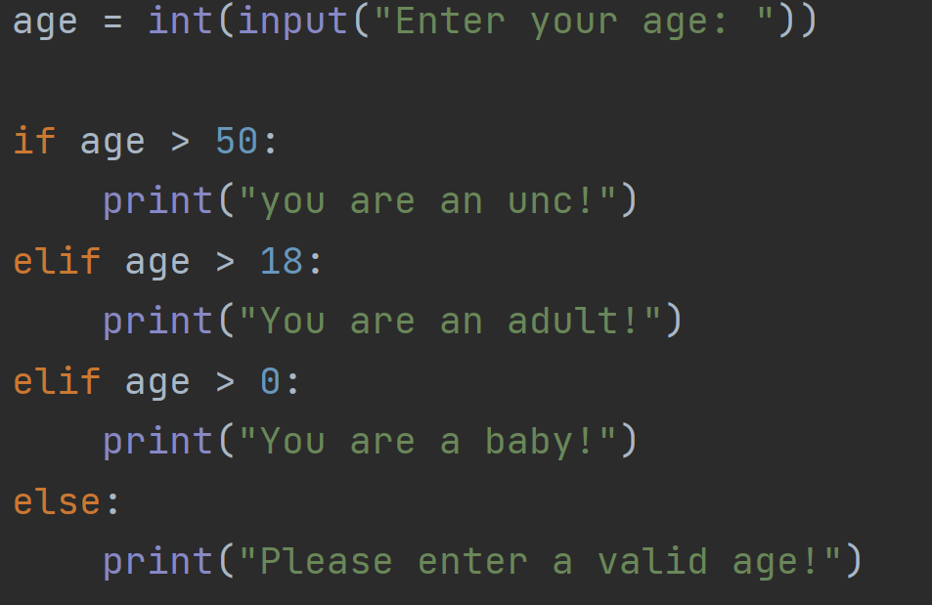
Review
For i in list:
do something

Slide 5
Comparison Operators
== equal to
!= not equal to
> greater than
< less than
>= greater than or equal to
<= less than or equal to

Slide 6

While loops
while condition:
repeats something while the condition is true
Again, Indentation is important!

Slide 7
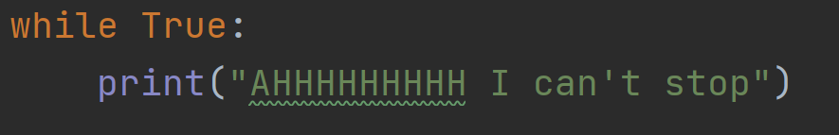
While loops

Slide 8
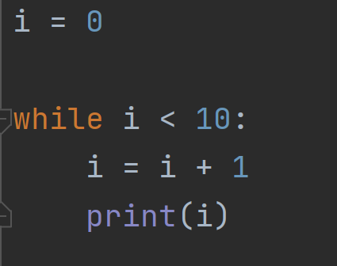
While loops

Slide 9
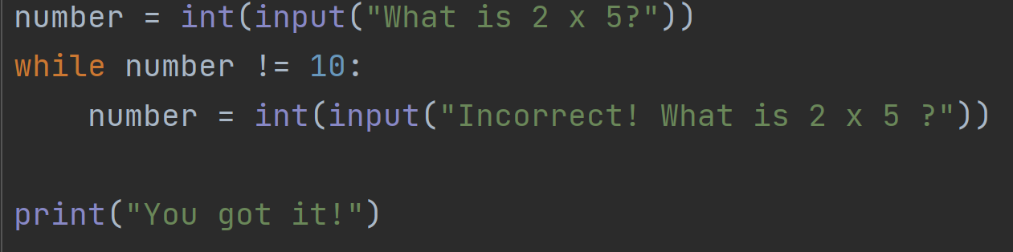
While loops

Slide 10
For loops
for x in range(n):
do something
This “something” repeats n times

Slide 11
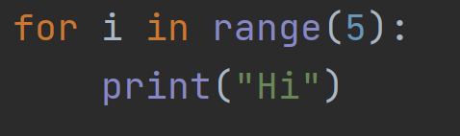
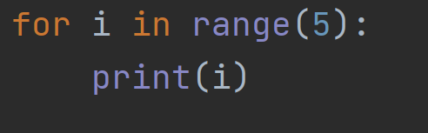
For loops

Slide 12
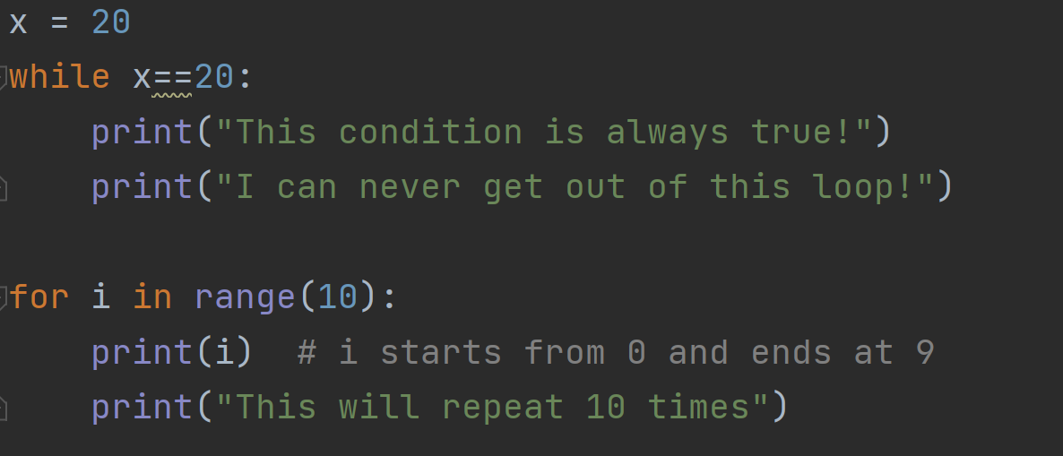
Summary

Slide 13
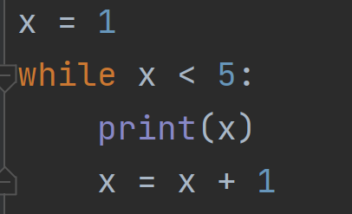
Quiz 1
Answer: A
What does this print
A. 1 2 3 4
B. 1 2 3 4 5
C. 0 1 2 3 4
D. Infinite loop

Slide 14
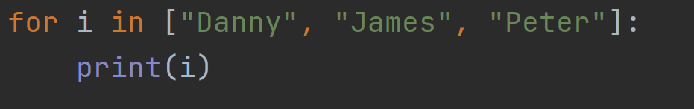
Quiz 2
Answer: B
What does this print
A. 0 1 2
B. Danny, James, Peter in separate lines
C. does not work
D. Danny, James, Peter in one line

Slide 15
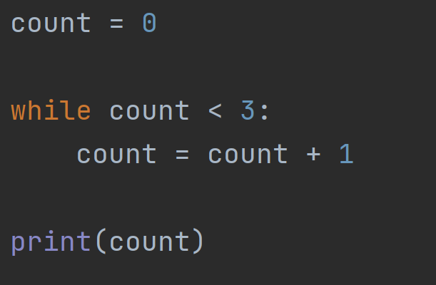
Quiz 3
Answer: C
What does this print
A. 0
B. 2
C. 3
D. Infinite loop

